Slide 1
Proposal 2019 Ramp Staging Area, W. Ramp Recovery Flow, and Aircraft Parking Plan Changes BACKGROUND
2019 NCAR preparation includes re-thinking of the Ramp Layout, Staging and Recovery Plans, as well as Aircraft Parking plans
Safety requirements dictate improved W Ramp recovery plans
Affects Sport, Biplane and Formula Classes
Improved Safety in Sport Recovery requires additional E-W space to ensure safety margins are maintained from turning props
Affects Sport, T-6 and Unlimited Classes
Also requires vigilance and compliance with ramp security rules
Cooperation among classes involved is key to safe and efficient flow

Slide 2
Proposal 2019 Ramp Staging Area, W. Ramp Recovery Flow, and Aircraft Parking Plan Changes OVERVIEW
Follow-on slides show:
Current ramp layout, with issues that require resolution
Current W Ramp recovery flow, with issues that require resolution
Recommended 2019 ramp layout, with changes requested to accomplish it
Benefits and Advantages of the recommended 2019 ramp layout
Sport W Ramp Recovery plan under new ramp layout
Biplane/Formula Recovery plan under new ramp layout
Matches the proposed plan submitted by Biplane class
SOP/Rules draft in work to support all of the proposed procedures

Slide 3
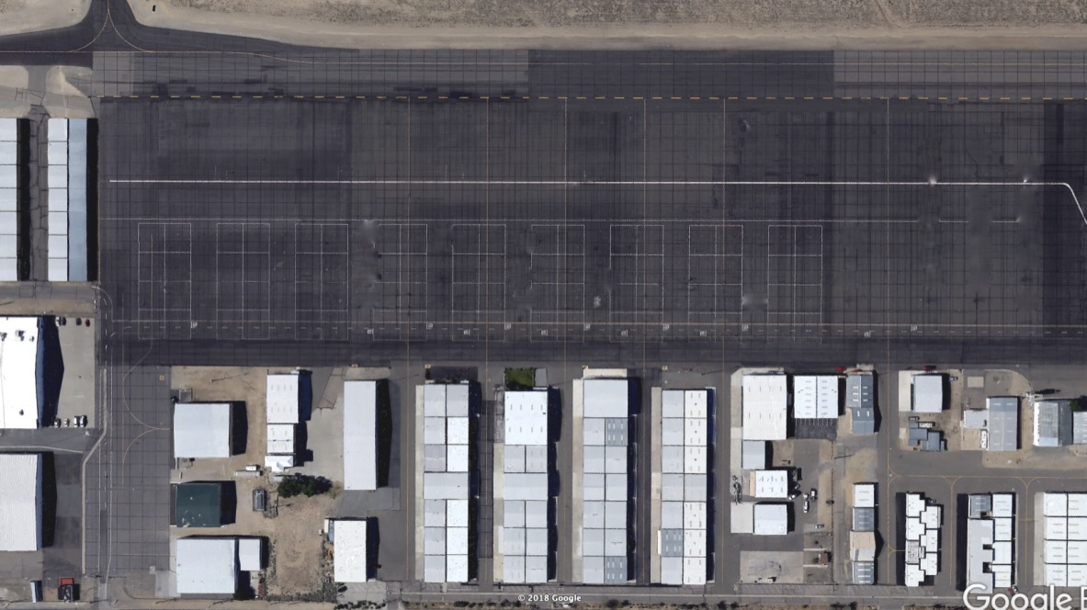
Current Ramp Layout Overview (presents crowding problems at W end)
Notes:
UNL Ramp allows staging 8 plus pace in front row row
T-6 Ramp allows staging 6 plus pace in front row
Sport Ramp constraints force staging 6 in front row, and 2 more, plus pace, in second row
During PRS, and NCAR practice and qualifying, ramp constraints force multiple rows of staged aircraft
Fuel Trucks at ground points 2 and 3. This puts fuel truck 1 too close to Sport Recovery
Issues to resolve:
Sport ramp space very constrained, creates safety issues
Sport parking spread among 5 locations
No F! or BP overflow parking area available near RARA hangar
Fuel Truck 1
Fuel Truck 2
FAA
T-6
T-6
T-6
T-6
UNL
UNL
UNL
UNL
CAF
CAF
Chalets
Seats
T-6
T-6
T-6
T-6
UNL
UNL
UNL
UNL
CAF
CAF
T-6
T-6
T-6
T-6
UNL
UNL
UNL
UNL
CAF
CAF
MH
T-6
T-6
T-6
T-6
UNL
UNL
UNL
UNL
CAF
CAF
1
2
V
M7
5
6
3
4
7
8
9
10
11
12
13
14
15
16
18
51 Aero
BP
1
F1
Sport

Slide 4
Sport Taxi from 26
Recovery Plan under Current Ramp Layout (not recommended)
Issues to Resolve:
Narrow Sport Ramp (W-E) makes single file recovery not possible
Sport recovery aircraft in 2 rows reduces safety margin
Fuel Truck 1 at current position limits Sport Recovery space and creates a possible nose-nose gridlock with F1/BP at truck Fuel Truck 1
Sport Taxi from 8
BP/Formula Tow
Fuel Truck 1
BP/F1 Shutdown here or tow from A2 to here
Fuel Truck 2
Sports Shutdown Here
FAA
T-6
T-6
T-6
T-6
UNL
UNL
UNL
UNL
CAF
CAF
Seats
T-6
T-6
T-6
T-6
UNL
UNL
UNL
UNL
CAF
CAF
T-6
T-6
T-6
T-6
UNL
UNL
UNL
UNL
CAF
CAF
MH
T-6
T-6
T-6
T-6
UNL
UNL
UNL
UNL
CAF
CAF
1
2
V
M7
5
6
3
4
7
8
9
10
11
12
13
14
15
16
18
51 Aero
BP
1
F1
Sport

Slide 5
Recommended New Ramp Layout
Change Notes:
Request Sport ramp be widened 100’ east (four expansion joints)
Request T-6 and Unlimited ramp areas shift 100’ east (no decrease in ramp size for T-6 and UNL.)
Request Fuel Trucks 1 and 2 be co-located at ground point 3, with 25’ space between them. Both can be grounded to GP3
Request T-6 and UNL pit rows be moved 1 row east (start T-6 pit parking in pit row 6, and flow from there)
Request the 6 Sport tents across from the RARA hangar be relocated to pit row 5
SEE BENEFITS AND ADVANTAGES OF THIS PLAN NEXT SLIDE
Fuel Trucks 1 & 2
FAA
T-6
T-6
T-6
T-6
UNL
UNL
UNL
UNL
CAF
CAF
Chalets
Seats
T-6
T-6
T-6
T-6
UNL
UNL
UNL
UNL
CAF
CAF
T-6
T-6
T-6
T-6
UNL
UNL
UNL
UNL
CAF
CAF
MH
T-6
T-6
T-6
T-6
UNL
UNL
UNL
UNL
CAF
CAF
1
2
V
M7
5
6
3
4
7
8
9
10
11
12
13
14
15
16
17
18
51 Aero
T-6
BP
1
Open for BP or F1 Parking
F1
Sport

Slide 6
Benefits of Recommended New Ramp Layout
Advantages:
Widened Sport Ramp allows Sport Recovery in single file line
Single File Sport Recovery increases ramp safety margins
Fuel Truck 1 and 2 being co-located allows efficient fueling and less potential for nose-to-nose gridlock
Pit Area Tow-out lanes for Sport, T-6 and UNL all go directly to their respective staging areas
Sport tents in pit row 5 offers more consolidated Sport parking
Moving Sport tents to pit row 5 opens the area across from RARA hangar for overflow F1 and/or BP parking
Fuel Trucks 1 & 2
FAA
T-6
T-6
T-6
T-6
UNL
UNL
UNL
UNL
CAF
CAF
Chalets
Seats
T-6
T-6
T-6
T-6
UNL
UNL
UNL
UNL
CAF
CAF
T-6
T-6
T-6
T-6
UNL
UNL
UNL
UNL
CAF
CAF
MH
T-6
T-6
T-6
T-6
UNL
UNL
UNL
UNL
CAF
CAF
1
2
V
M7
5
6
3
4
7
8
9
10
11
12
13
14
15
16
17
18
51 Aero
T-6
BP
1
Open for BP or F1 Parking
F1
Sport

Slide 7
Sport Taxi from 26
Sport Recovery Plan under New Ramp Layout (Recommended)
Notes:
Aircraft marshalled in by 3 marshallers in single file line
Lead aircraft will be stopped 2 plane lengths from fuel truck 1
Aircraft will shut down as they come to final stop in line (in sequence, no waiting)
3rd Marshaller ensures NO COASTING UP TO FUEL TRUCK
NO CREW MAY CROSS RED LINES UNTIL ALL RECOVERING AIRCRAFT HAVE SHUTDOWN
If second Sport wave is staged, all staged racer’S crews must remain at planes until recovering aircraft are shut down
Ramp Chief/QB maintains overwatch of margins and has red flag for “all stop”.
Aircraft tow from shutdown spot to Fuel Trucks and then to parking
Two aircraft may be fueled efficiently with fuel trucks co-located
After fueling aircraft are towed in right turn around fuel truck into the lane between the NPTL and the K-rails
Sport Taxi from 8
Marshaller
Ramp Chief QB
Sports Shutdown Here
Fuel Trucks
Tow to Parking
FAA
T-6
T-6
T-6
T-6
UNL
UNL
UNL
UNL
CAF
CAF
Chalets
Seats
T-6
T-6
T-6
T-6
UNL
UNL
UNL
UNL
CAF
CAF
T-6
T-6
T-6
T-6
UNL
UNL
UNL
UNL
CAF
CAF
MH
T-6
T-6
T-6
T-6
UNL
UNL
UNL
UNL
CAF
CAF
1
2
V
M7
5
6
3
4
7
8
9
10
11
12
13
14
15
16
17
18
51 Aero
T-6
1
Open for BP or F1 Parking
Sport

Slide 8
BP/F1 Recovery Plan under New Ramp Layout (Recommended)
Notes:
Aircraft towed from shutdown/hook-up spot just W of Chalets
Aircraft towed to fuel trucks via lane between NPTL and K-rails
Approaching Fuel Truck 2, aircraft towed N of trucks for refueling
Two aircraft may be fueled efficiently with fuel trucks co-located
After fueling, aircraft towed back into recovery lane and to parking
If Sport is recovering, they shutdown and hold well west of fuel trucks (widened Sport ramp facilitates this)
BP/Formula Tow Recovery
Ramp Chief QB
BP/F1 Shutdown here or tow from A2 to here
Fuel Trucks
Tow to Parking
FAA
T-6
T-6
T-6
T-6
UNL
UNL
UNL
UNL
CAF
CAF
Chalets
Seats
T-6
T-6
T-6
T-6
UNL
UNL
UNL
UNL
CAF
CAF
T-6
T-6
T-6
T-6
UNL
UNL
UNL
UNL
CAF
CAF
MH
T-6
T-6
T-6
T-6
UNL
UNL
UNL
UNL
CAF
CAF
1
2
V
M7
5
6
3
4
7
8
9
10
11
12
13
14
15
16
17
18
51 Aero
T-6
1
Open for BP or F1 Parking
Sport

Slide 9
Sport Class 2019 Parking Assignments
Fuel Trucks 1 & 2
FAA
12 (P)
232
39
T-6
T-6
T-6
T-6
UNL
UNL
UNL
UNL
CAF
CAF
Chalets
Seats
17
49
47
36
80
314
24
T-6
T-6
T-6
T-6
UNL
UNL
UNL
UNL
CAF
CAF
31
101
54
68
With D. Sanders
14
270
888
3
T-6
T-6
T-6
T-6
UNL
UNL
UNL
UNL
CAF
CAF
28
MH
42
34
T-6
T-6
T-6
T-6
UNL
CAF
181
22
UNL
UNL
UNL
CAF
91
1
2
V
M7
5
6
25
2
3
4
7
8
9
10
11
12
13
14
15
16
17
18
TacAir
51 Aero
611
56
66
151
67
15
BP
1
RARA
AAR
61
F1
Gabriel
Hangar
44
30
90
99
Sport HQ

